Slide 1
HNDIT1032 Computer and Network Systems
Week 09- Software & Operating System

Slide 2
Introduction
The computer, as a machine, can do nothing for you without the software.
Software is required for the functioning of computer.
Software programs instruct computer about the actions to be performed, so as to get the desired output.

Slide 3
Software
A computer system consists of hardware and software.
Software is a set of programs that instructs the computer about the tasks to be performed.
Software tells the computer how the tasks are to be performed; hardware carries out these tasks.

Slide 4
Types of Software
Software can be broadly classified in two categories:
System Software.
Application Software.

Slide 5
System Software
The purposes of the system software are:
To provide basic functionality to computer,
To control computer hardware, and
To act as an interface between user, application software and computer hardware.

Slide 6
Categories of System Software
On the basis of their functionality, system software may be broadly divided into two categories
Management and functionality of computer.
Development of application software

Slide 7
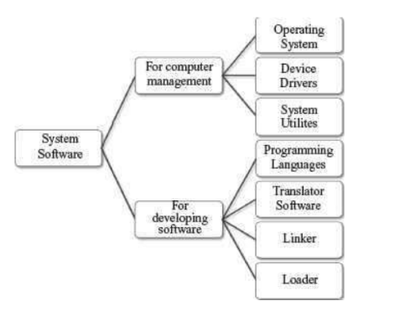
Categories of System Software

Slide 8
Application Software
The software that a user uses for accomplishing a specific task is the application software.
Application software may be a single program or a set of programs.
A set of programs that are written for a specific purpose and provide the required functionality is called software package.

Slide 9
Examples of Application Software
Word Processing Software
Image Processing Software
Accounting Software
Spreadsheet Software
Presentation Software
CAD/CAM Software
Web Browser Software

Slide 10
Software Market
Retail Software
OEM Software stands
Demo Software
Shareware
Freeware
Public Domain Software
Open-Source Software

Slide 11
Operating System(OS)
Any computer system you use has an operating system.
The user interacts with the machine via the operating system.
A software on the machine interacts with the hardware via the operating system.
Operating system intermediates between the hardware and the user.

Slide 12
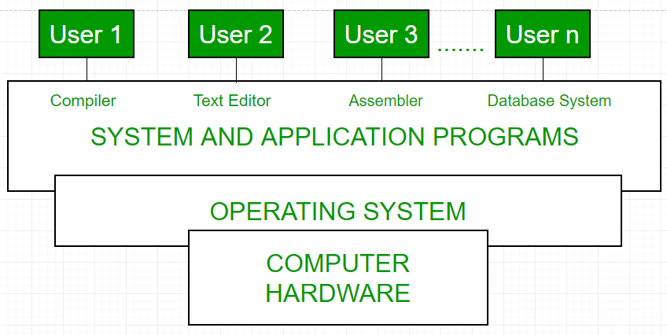
View of OS

Slide 13
Types of OS
Single User and Single Task OS
Single User and Multitasking OS
Multiuser OS
Multiprocessing OS
Real Time OS
Embedded OS(bill)

Slide 14
Single User Single Task
This is for use by a single user for a standalone single computer for performing a single task.
Operating system for Personal Computers (PC) are single user OS.
For example, if the user is editing a document, then a document cannot be printed on the printer simultaneously.
Example MS DOS

Slide 15
Single User Multitasking
This is allows execution of more than one task or process concurrently.
The processor switches rapidly between processes.
For example, the user can listen to music on the computer while writing an article using a
word processor software.
Example Windows OS.

Slide 16
Multiuser OS
This is used in computer networks that allow same data and applications to be accessed by multiple users at the same time.
Linux, UNIX, and Windows are examples of multi user OS.

Slide 17
Multiprocessing OS
This have two or more processors for a single running process.
Processing takes place in parallel and is also called parallel processing.
Since execution takes place in parallel, they are used for high speed execution, and to increase the power of computer.
Linux, UNIX and Windows

Slide 18
Real Time OS
Real time OS are designed to respond to an event within a predetermined time.
These operating systems are used to control processes. Processing is done within a time constraint.
They are used to respond to queries in areas like medical imaging system, industrial control systems etc.

Slide 19
Embedded OS
This is embedded in a device in the ROM.
They are specific to a device and are less resource intensive.
They are used in appliances like microwaves, washing machines, traffic control systems etc.

Slide 20
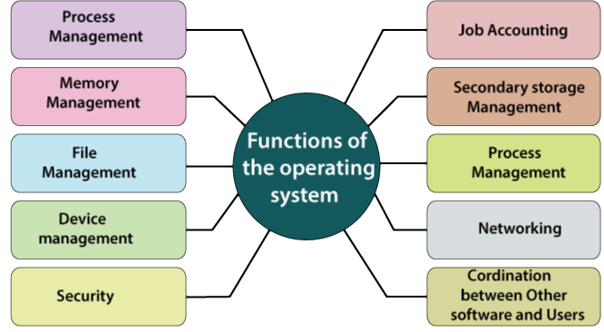
Functions of OS
Process Management
Memory Management
File Management
Device Management
Protection & Security
Communication
User Interface

Slide 21
Process Management
A process is a program in a state of execution.
A process can be created, executed, and stopped.
To accomplish a task, a process needs to have access to different system resources like I/O devices, CPU, memory etc.
The process management function of an operating system handles allocation of resources to the processes in an efficient manner.

Slide 22
Memory Management
In a computer, there may be multiple processes executing at the same time.
Memory management is one of the tasks handled by the operating system.
Memory management schemes handle the allocation of memory to different processes.
Paging,Virtual memory

Slide 23
Virtual Memory
A computer can address more memory than the amount physically installed on the system.
This extra memory is actually called virtual memory and it is a section of a hard disk that's set up to emulate the computer's RAM.

Slide 24
File Management
The file management function of the operating system involves handling the file system which consists of two parts—a set of files, and a directory structure.
File is a collection of related information, has a name, and is stored on a secondary storage.
It is the smallest named unit that can be written to a secondary storage device.

Slide 25
Device Management
An operating system communicates with the devices controllers with the help of device drivers while allocating the device to the various processes running on the computer system.
Device drivers are the software programs that are used by an operating system to control the functioning of various devices in a uniform manner.

Slide 26
Protection & Security
User accounts—individual accounts for user Authentication—using password protection
Access rights—define rights for access of different kind of information for different
people.
Data encryption—store data

Slide 27
User Interface(UI)
The primary goal of operating system is to make the computer convenient for use by its user.
It should allow users to easily access and communicate with the applications and the hardware.

Slide 28
Types of UI
The users can interact with the computer by using mainly two kinds of interfaces
Command Line Interface (CLI)
Graphical User Interface (GUI)

Slide 29
Command Line Interface
CLI requires the user to interact with operating system in the form of text keyed in from the keyboard.
In this, the user has to learn and remember the different commands required for copying, deleting, opening a file or folder etc.
Example MS-DOS & Linux shell

Slide 30
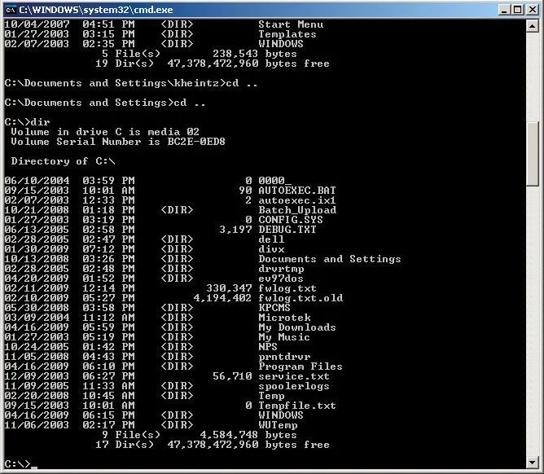
Example- MS-DOS

Slide 31
Graphical User Interface
The interface consists of icons, menus, windows, and pointers.
The user need not learn the commands, instead, the user can give instructions by moving the pointer on the screen using a mouse and pressing the mouse button
MS Windows, Linux, Mac OS

Slide 32
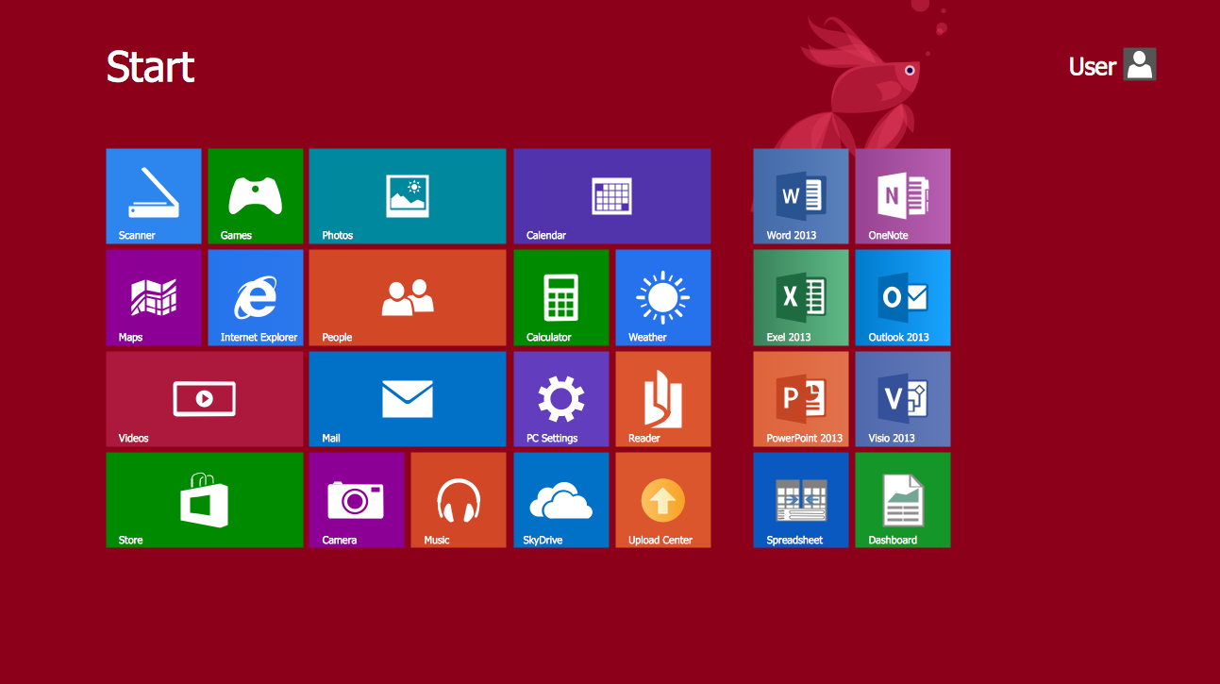
Example-GUI

Slide 33
Examples of OS
Ms DOS
Windows 11
Linux
Mac OS
Android
IOS

Slide 34
MS-DOS
MS-DOS was the first widely-installed operating system for PCs in 1980s.
MS-DOS is easy to load and install. It neither requires much memory for the operating system, nor a very powerful computer to run on.
MS-DOS is a command line user interface operating system. This means that the user has to type single line commands through the command interface.

Slide 35
Windows OS
Windows is a personal computer operating system from Microsoft.
The Windows family of OS which is currently in use includes the Windows 9x family (Windows 95, Windows 98 and Windows 2000), Windows XP, Windows Vista, and Windows 7,8,11 operating systems.
Windows family of OS is GUI-based operating system. Since GUI interfaces are easy to use and are user-friendly, these have become very popular.

Slide 36
Linux OS
Linux is a 32-bit, multi-tasking OS. It supports multiple users and multiple processors.
Linux is a reliable and secure OS, and is available almost for free. So, Linux is fast becoming very popular and powerful OS.
Linux OS is easily available, such as Redhat Linux ver. 9, and, Debian∙s—Ubuntu,Kubuntu, and Edubuntu.

Slide 37
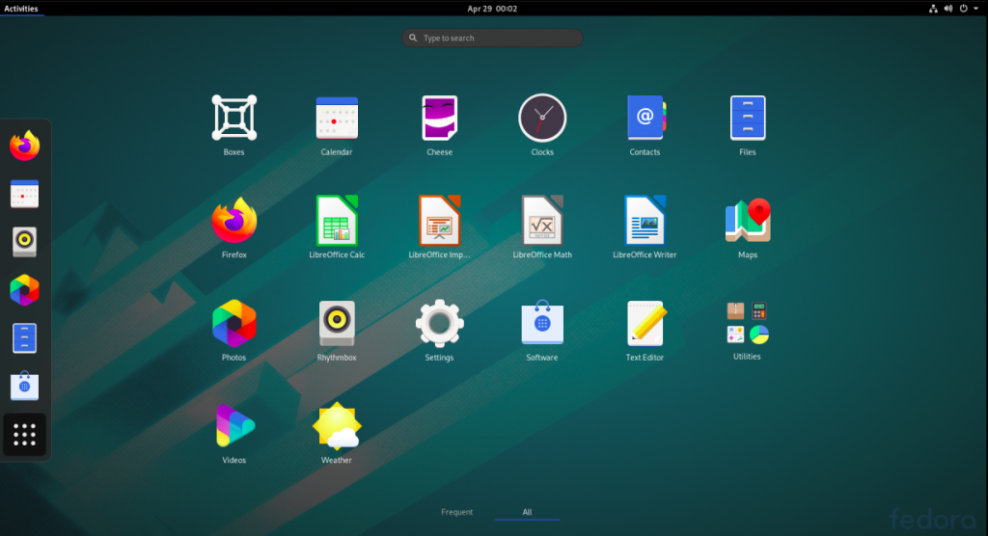
Example-Linux OS

Slide 38
MacOS
MacOS is a Unix operating system developed and marketed by Apple Inc since 2001.
It is the primary operating system for Apple's Mac computers.
Within the market of desktop and laptop computers it is the second most widely used desktop OS.

Slide 39
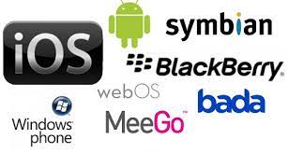
Mobile OS

Slide 40
References
Clements, A., The Principles of Computer Hardware, Oxford University Press (4th Ed), 2006.

